Slide 1


Embedded programing course
IoT-TLU Laboratory

Slide 2
Motor controlling
Lab #2: Working with Switch
Lab #3: DC Motor Controlling using IC
Lab #4: DC Motor Controlling using module L298
Lab #5: Controlling a Step Motor

Slide 3
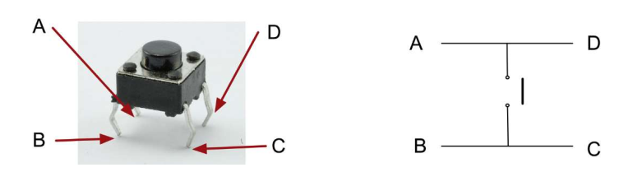
Working with Switch
Let's programmatically detect input from the device
We use tactile (tact) switches as input devices
Be very aware of its shape!
A-D, and B-C are connected, but nether A-B nor D-C
Connect A or D to VDD
Connect B or C to GND
When you press a button, the circuit will be connected (current goes through)

Slide 4
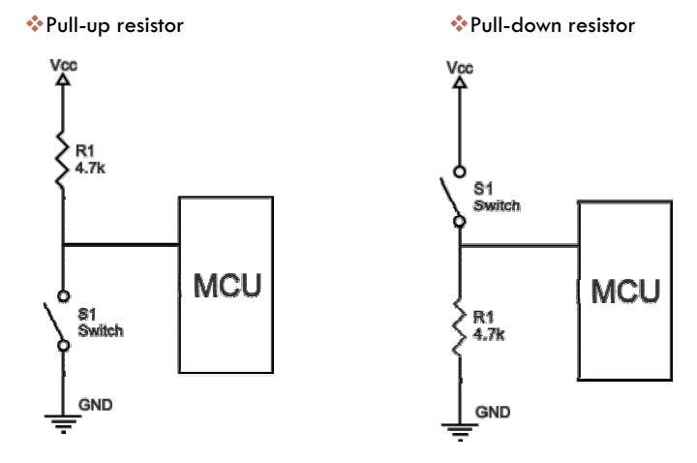
Working with Switch – Pull-Up & Pull-Down

Slide 5
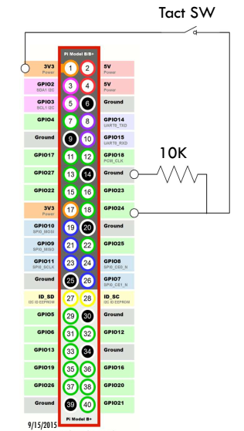
Working with Switch
When you press down the switch, GPIO24 (Pin18) get sink current
Other wise, GPIO24 is connected to GND
The role of resistor, like this usage, is called "pulldown resistor"
The 10K resistor ensures that only a little current is drawn when the switch is pressed
By using the pulldown, you make sure GPIO24 reads LOW, and when pressing the switch GPIO24 reads HIGH

Slide 6
Working with Switch
Consider without the resistor and the state SW open
The circuit is not closed
You cannot tell HIGH or LOW on GPIO24!

Slide 7
Working with Switch
So, now you know what to do with your software
Set GPIO24 (pin18) to input
Inside a loop, read value of the pin
If it reads 1, the button is being pressed
If it reads 0, the button is not pressed
Let's implement
Boot up your Pi
Connect via Remote Desktop
"sudo idle" to start IDLE with root priviledge
"CTRL+n" to create a new file

Slide 8
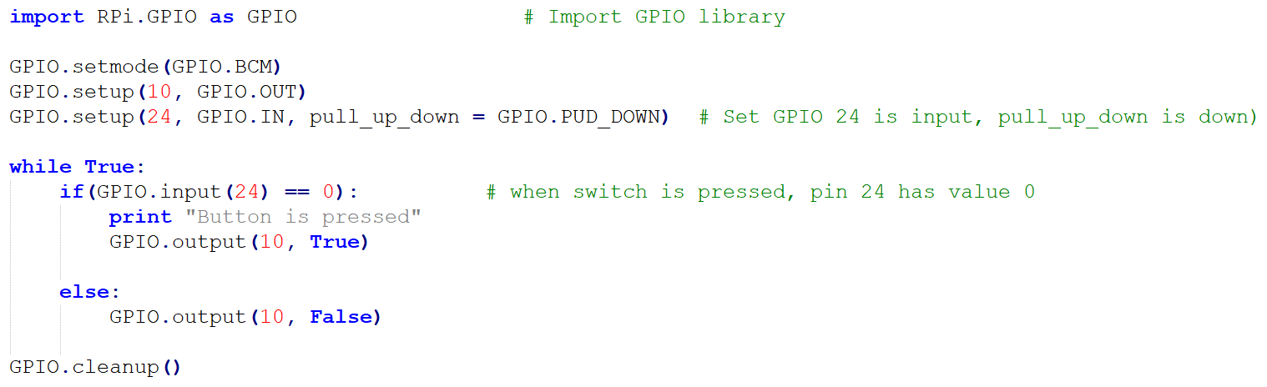
Working with Switch
Type the following (be careful with 4-spaces indent), and save as "switch.py“
Hit F5 to run the program
Press the tactile switch and observe the console output
CTRL+C to exit the program

Slide 9
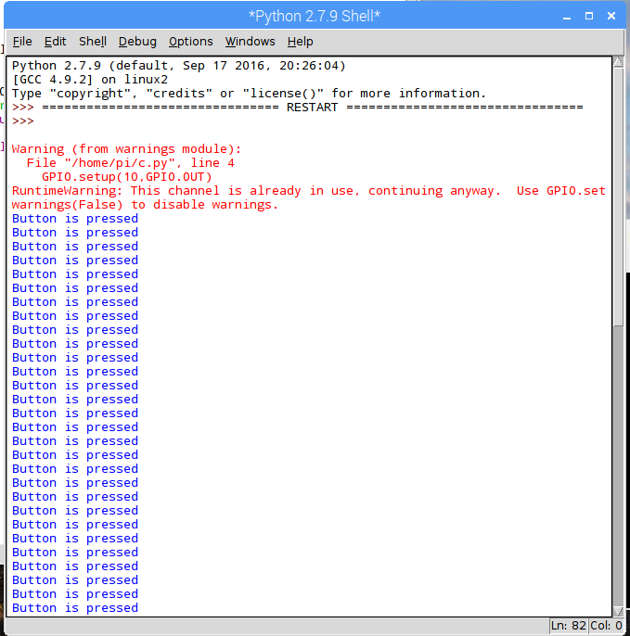
Working with Switch

Slide 10
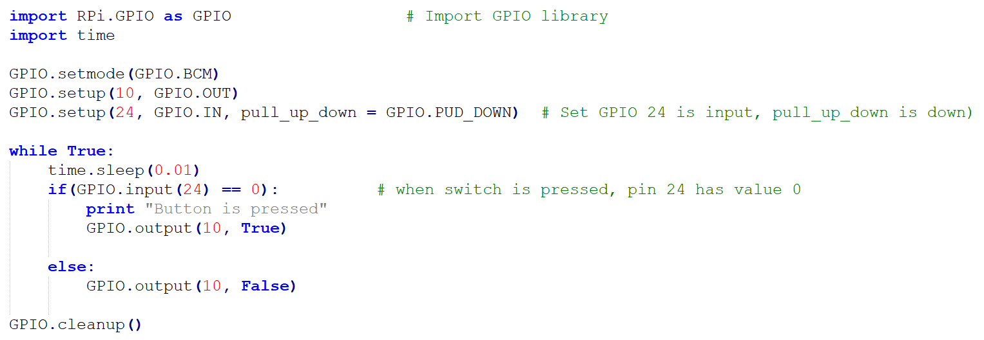
Working with Switch
The following code lowers the sampling rate for the switch state detection, but more comfortably works with other processes inside OS

Slide 11
Working with Switch - Interrupts
With interrupts, you can define a certain condition to watch for, and define what to do the condition occurs
For the given condition, the defined what-to-do ("event handler", or "callback", or "interrupt service routine") will kick in whatever the process is currently doing.
Internally, the callbacks runs in a separate dedicated thread for callback, which means that callback functions can be run at the same time as your main program, in immediate response to an edge.
Be aware, multiple callbacks still in a same thread, so the callbacks run in sequence
When working for embedded software, utilizing interrupts is a key to success
One of the utilization is a design pattern called "State Machine"

Slide 12
Working with Switch - Interrupts
Using Rpi.GPIO, you can set the condition and the callback
The above example, Pin 24 is set as input and internal pull-up resistor is activated, so default value is HIGH. When the event of Pin24 start falling, the function named "my_callback" will be executed, even the process calls sleep()

Slide 13
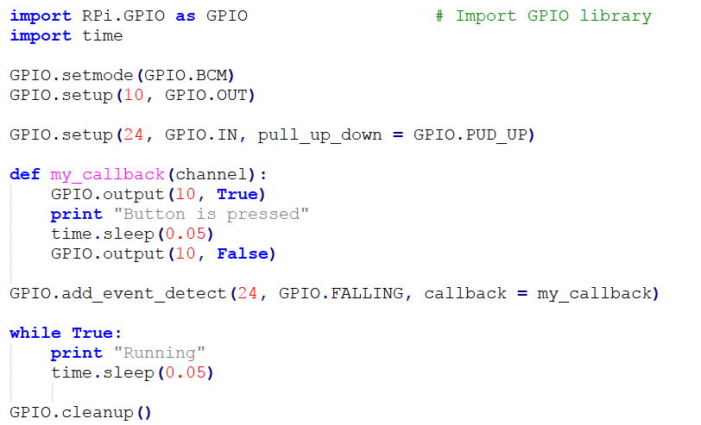
Working with Switch - Interrupts

Slide 14
Working with Switch - Debouncing
Sometimes, the callbacks are called more than once for each button press.
This is as a result of what is known as "switch bounce", or "chattering". There are 3 ways of dealing with switch bounce
Add a 0.1uF capacitor across your switch.
Software debouncing
A combination of both
Software debouncing is easy with RPi.GPIO. Just specify the duration for ignoring repeated event occurrences
this ignores 500ms for GPIO.RISING event

Slide 15
Motor controlling
Lab #2: Working with Switch
Lab #3: DC Motor Controlling using L298
Lab #4: DC Motor Controlling using wiringPi library
Lab #5: Controlling Motor speed

Slide 16
Controlling High-Voltage Peripherals
The Pi can only provide 3.3V or 5V from itself
When you want to control a motor or devices which requires higher voltage, such as 9V or 12V, you need an extra power supply in order to drive them
Furthermore, even for the 5V device, a device like a motor requires much power to drive it. If you supply 5V to the motor from the Pi, system will become unstable. So adding dedicated power supply for those is always a good idea
There are 2 solutions:
Buy and use a dedicated integrated IC
Add a transistor called as MOSFET (metal oxide semiconductor field effect transistor)

Slide 17
MOSFET “IRF9530”
IRF9530 is a P-channel Enhancement Mode MOSFET
There are two types: N-Channel (NMOS) or P-Channel (PMOS)
N-Channel the source is connected to ground. To turn the MOSFET on, we need to raise the voltage on the gate. To turn it off we need to connect the gate to ground.
P-Channel The source is connected to the power rail (Vcc). In order to allow current to flow the Gate needs to be pulled to ground. To turn it off the gate needs to be pulled to Vcc.
In short: To connect a source and a drain, you set LOW for a pin connected to the gate. To disconnect a source and a drain, you set HIGH

Slide 18

MOSFET “IRF9530”
We use MOSFET "IRF9530" to control a motor, which drive with 5V
With MOSFET, when you provide a certain voltage to a gate pin, circuit will connect from a source pin to a drain pin (think the gate as a switch)
Please make sure you understand the pins' role (gate – drain - source) from the right diagram. The Iron plate is a good marker for the identification of pins
Connecting 5V to source, and apply 3.3V on gate, then you will get 5V output voltage from drain
Make sure ground level for both 3.3V and 5V circuits are equalized (connect both GND)
Technically speaking IRF9530 is 4V gate drive, but it works with 3.3V

Slide 19
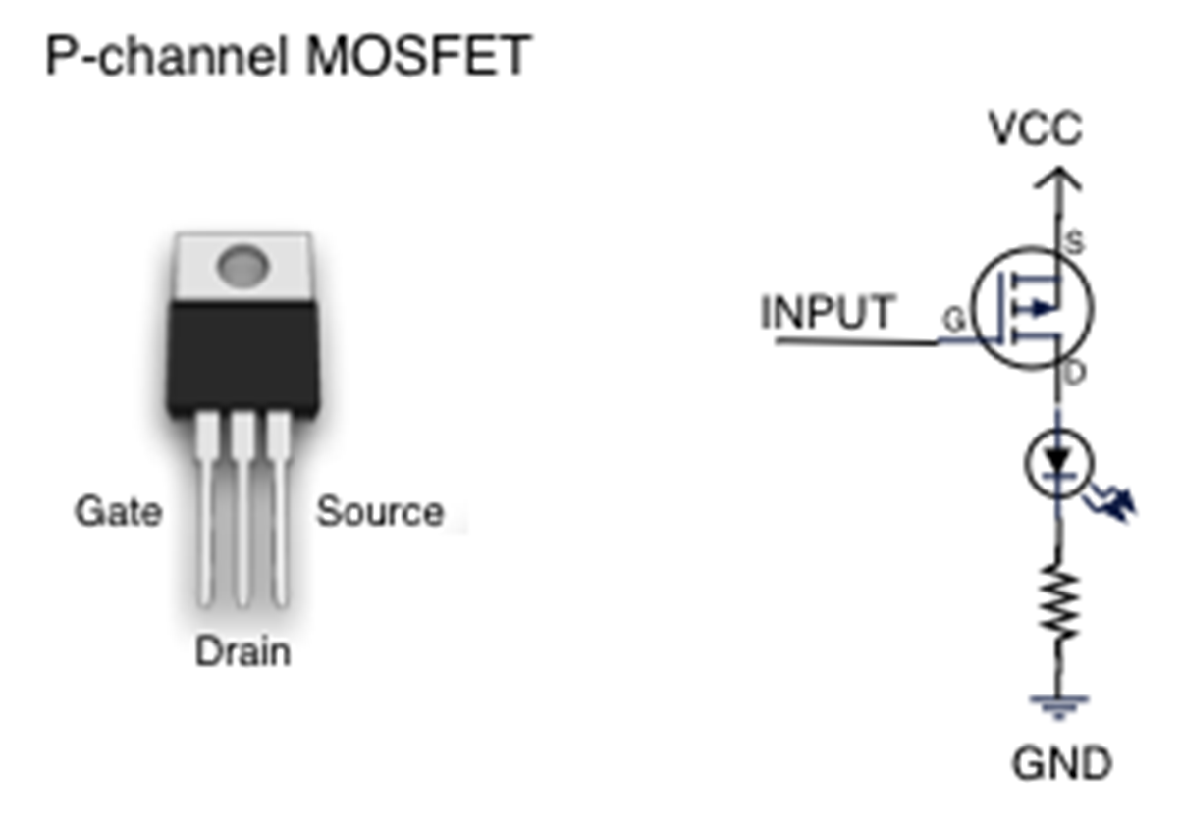
MOSFET “IRF9530”

Slide 20
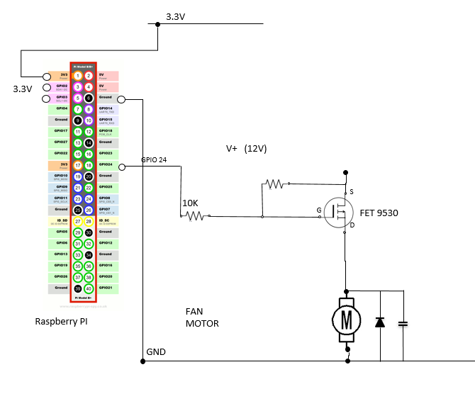
MOSFET “IRF9530”

Slide 21
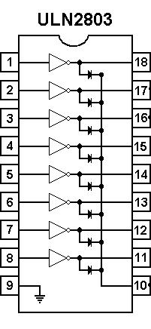
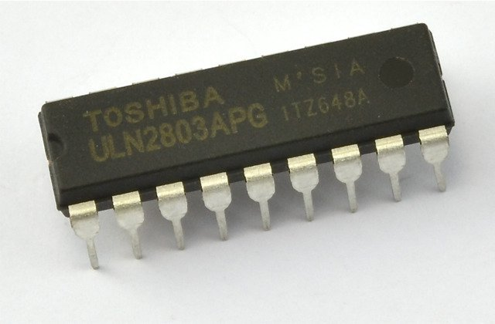
Motor driving ULN2803
ULN2803 is a High voltage, high current Transistor Array IC used especially with Microcontrollers where we need to drive high power loads. Thic IC consists of a eight NPN Darlington connected transistors with common Clamp diodes for switching the loads connected to the output. This IC is widely used to drive high loads such Lamps, relays, motors etc. It is usually rated at 50v/500mA.

Slide 22
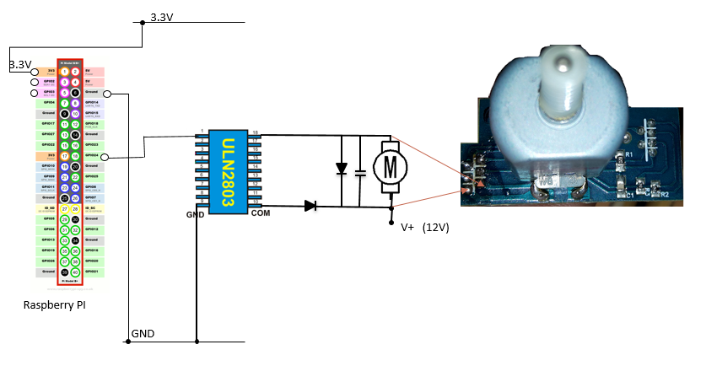
Motor driving ULN2803

Slide 23
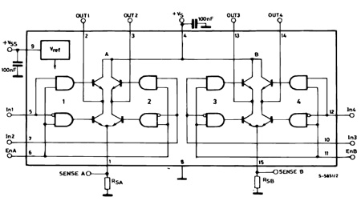
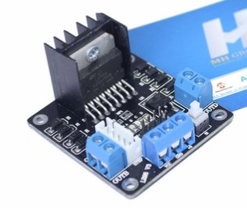
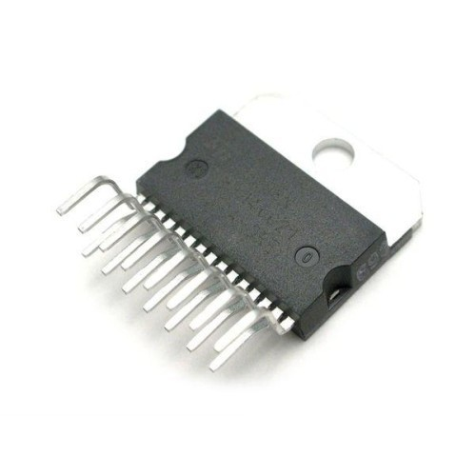
Module L298

Slide 24
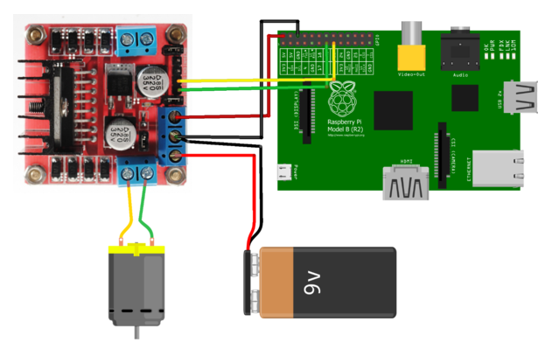
Module L298

Slide 25
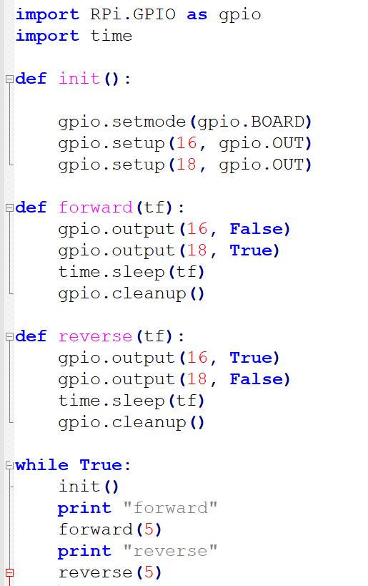
Module L298

Slide 26
QUESTIONS?

